Slide 1
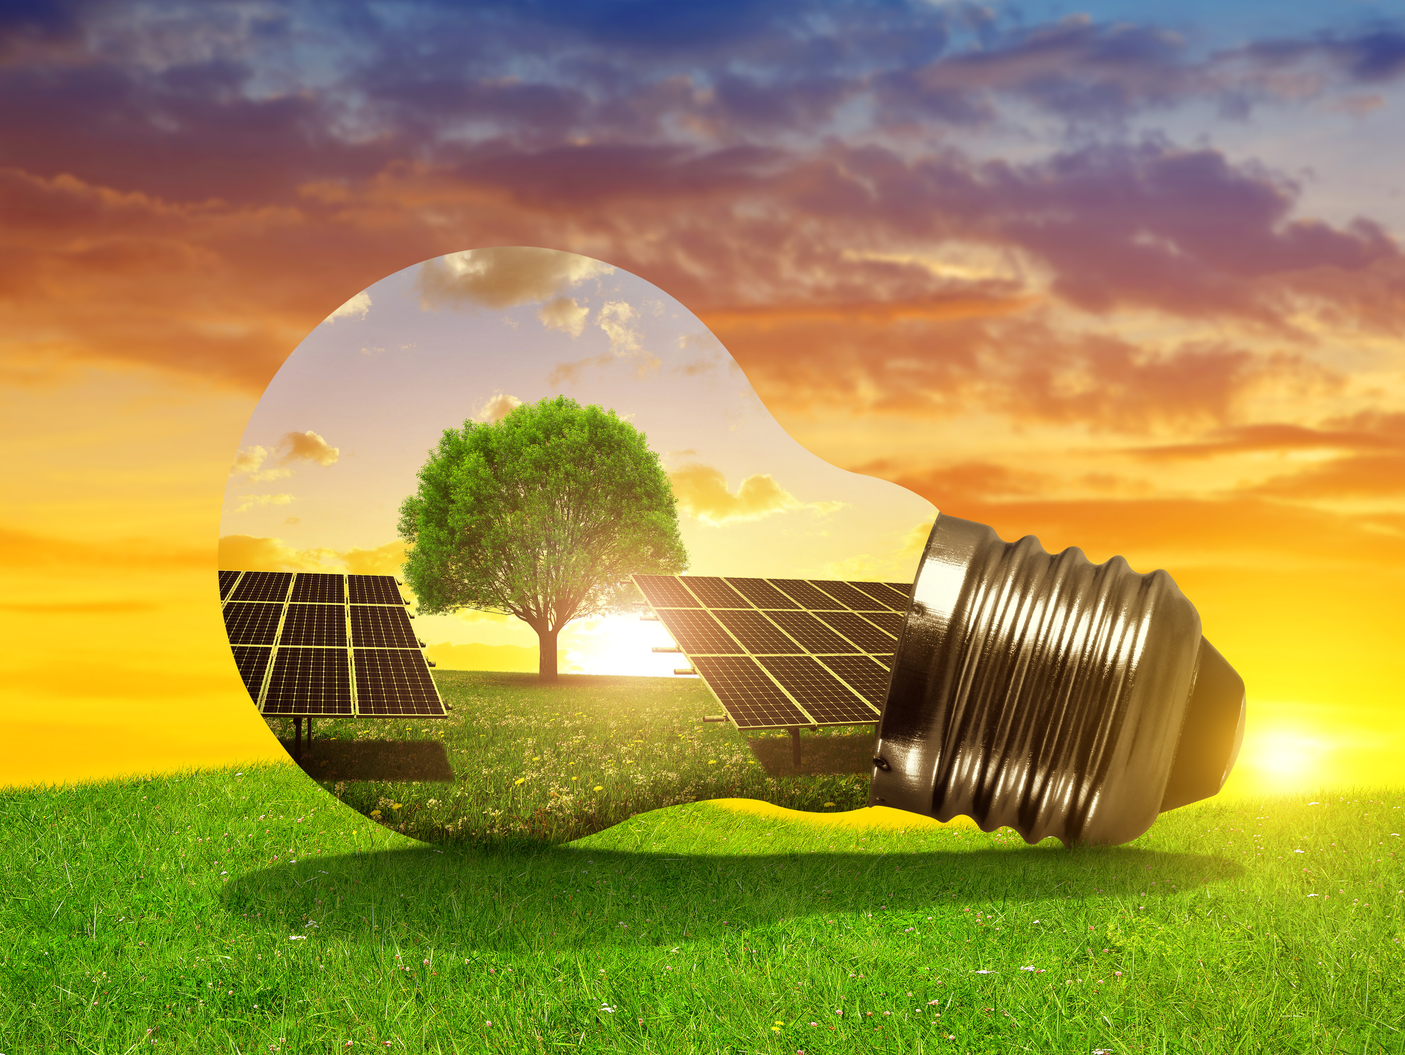
GRADUATION PROJECT
PRESENTATION
SOLAR PANELS
RETURN ON INVESTED CAPITAL
Notes:
Henry

Slide 2
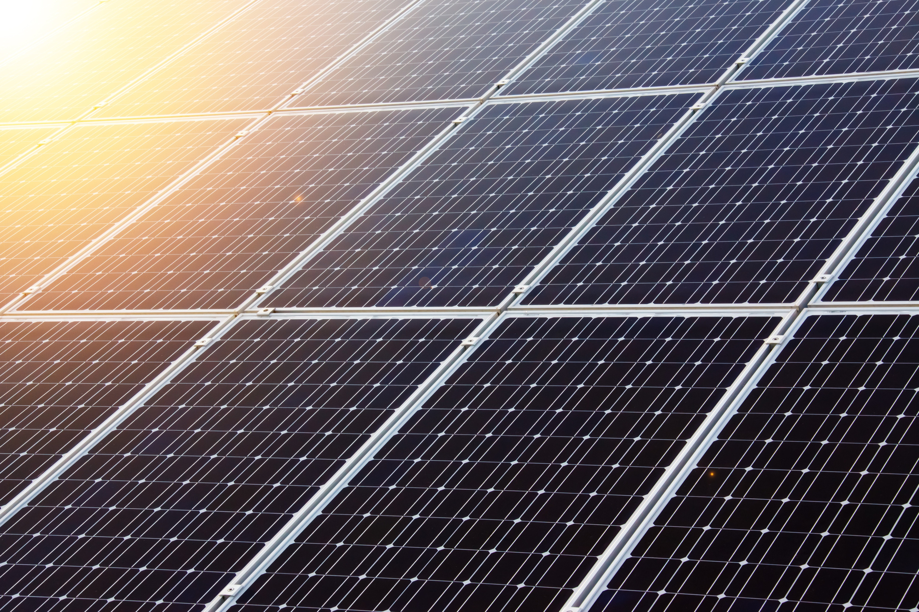


Introduction
Notes:
2,5 veckor sedantyp av examensprojekt.
ett tema: SUSTAINABILLITY, hållbarhet och FNs hållbarhetsmål "agenda 2030”
senare efterbrainstormande, kom gruppen fram till förnybar energi.
bredoch politisk fråga, politiker och makthavare kan göra stor skillnad. Vad kan privatpersoner göra då?
landade i solpaneler, potentiellt kan ju varje villaägare installera solceller.
harinte alla husägare solpaneler? stortstartkapital för att investera.
hjälpasteg närmare ett bättre klimat och en renare miljö.
Skapaten applikation, enkel att använda, knappstryck som ger oss informationså berättar vi omhur många år du har tjänat tillbaka.
Ominte bättre klimat och renare miljö motivera folk att invistera så tror vi att om vi bevisar att det är en smart investering som också kan generera pengar
till hushållen så kan det hjälpa till att motivera folk.
Men, jag går händelserna i förväg.

Slide 3
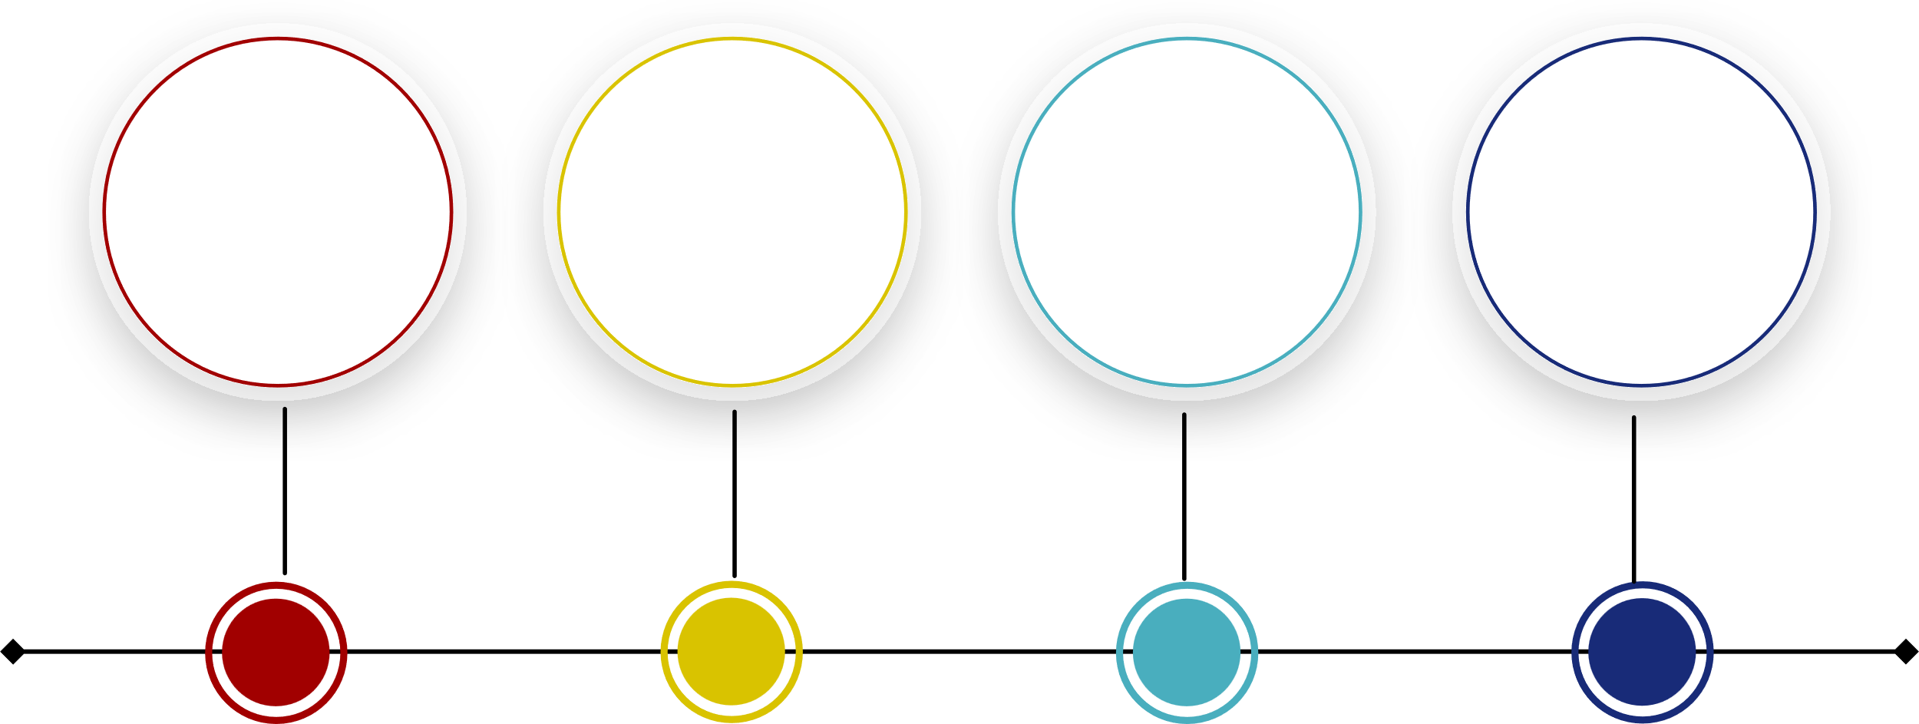
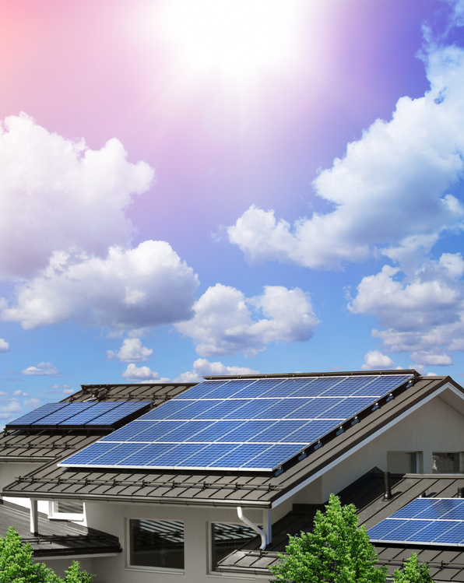
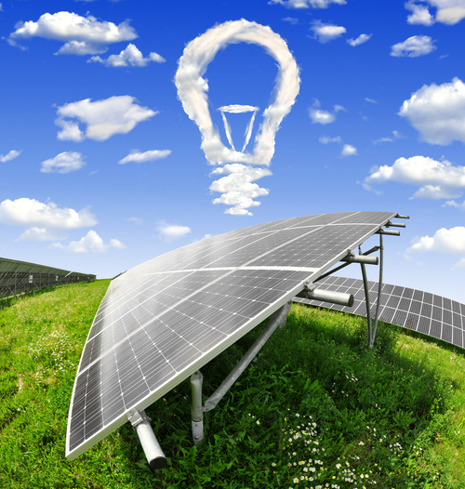
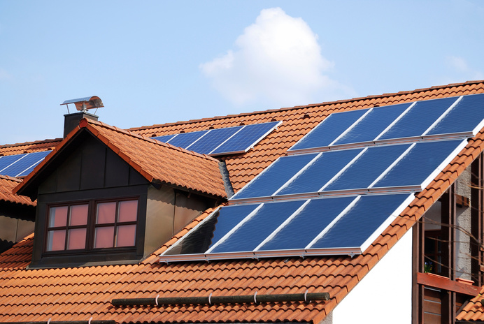
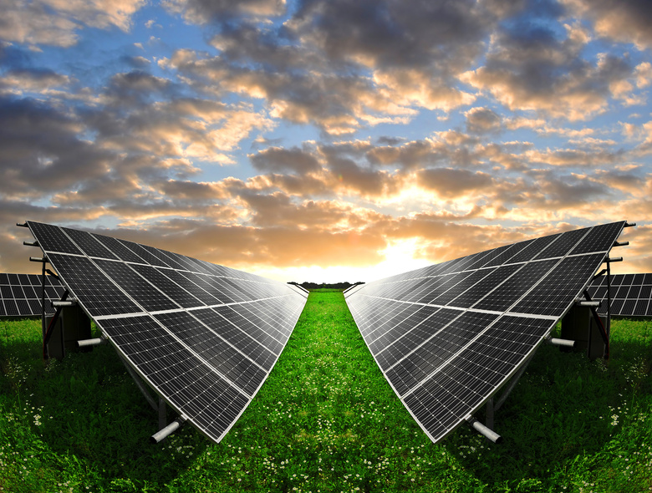
Agenda
THE PROBLEM
THE SOLUTION
THE DEMO
THE TECHNIQUES
Notes:
Så under den här presentationen kommer vi att gå igenom:
-The problem:
Det har jag ju redan gått in på lite grann men lite upprepning skadar ju inte.
-The solution:
Det är så sklart slutprodukten som vi pratar om här. Den är nog mer PART OF the solution, men ni förstår vad jag menar
-The demo:
Ni kommer få ta del av en live-demo av produkten
-The Techniques:
Och vi kommer gå in närmare på detaljerna kring arbetet, det tekniskas bakom produkten och vilka olika typer av tekniker vi använt oss av för att skapa produkten.

Slide 4

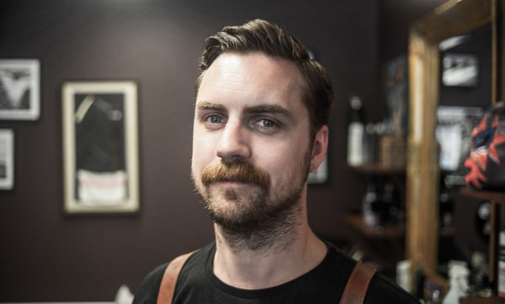
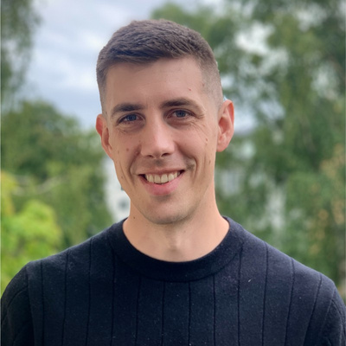
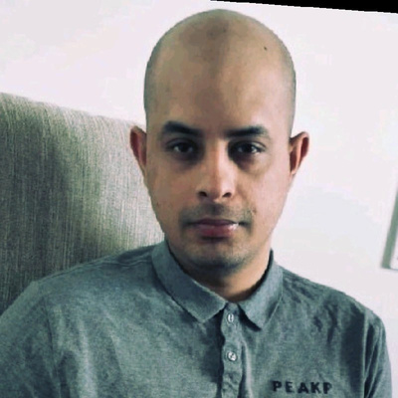
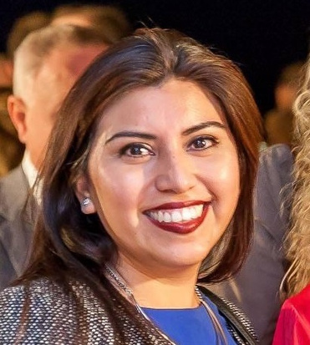
Meet the team
HENRY APLER
SIMON JANLÖV
KHAQAN YOUSAF
DANIELA BARRERA
Notes:
Alla
Who we were before the course
Our role in this project or during the presentation
Daniela: Jag jobbade för 6 år som projekt ledare inom travel retail området for olika varumärket inom norden när jag hade ansvar för deras personal och försalning. Sen byte jag till en tuffare och mycket mer spännande jobb som mamma av två små tjejer.

Slide 5
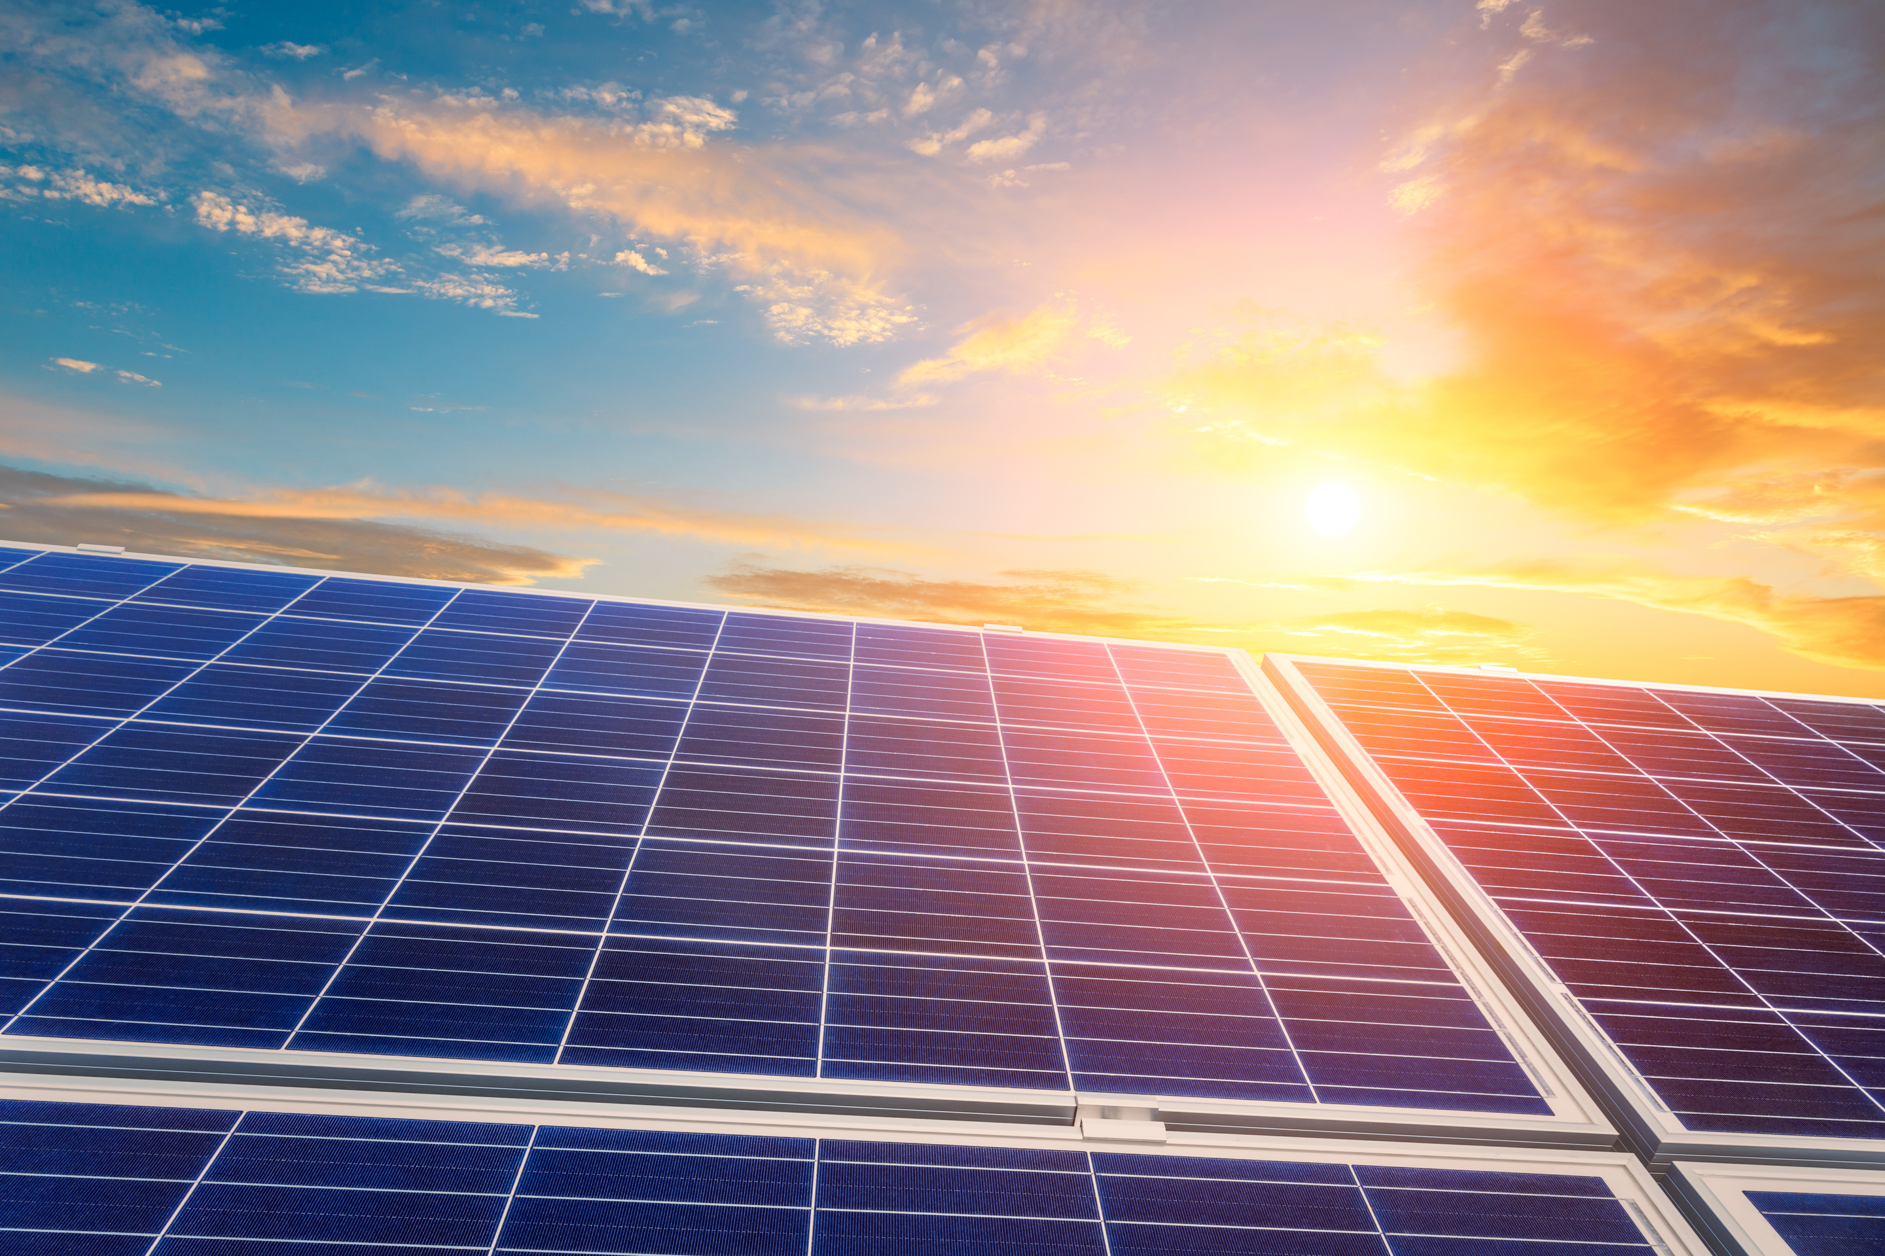


The Problem
History
Do you believe in climate change?
Do you know how much of Sweden’s energy production is solar?
0.2%
What is one of the main reasons stopping people from getting solar panels?
Notes:
Before we start, I have some questions:
- Do you believe in climate change?
Great! We are all on the same page.
Now, do you know how much of Sweden energy production is solar?
Under 1%. But it’s the renewable energy that with the strongest support in general opinion. So there is a lot of potential. A private person might not be able to set up their own wind power plant, but they can set up solar panels in their roof.
So, what is stopping people from do it? Well… money. There is an investment to be made and sometimes is not clear when you will see a return on that investment.
Dani

Slide 6
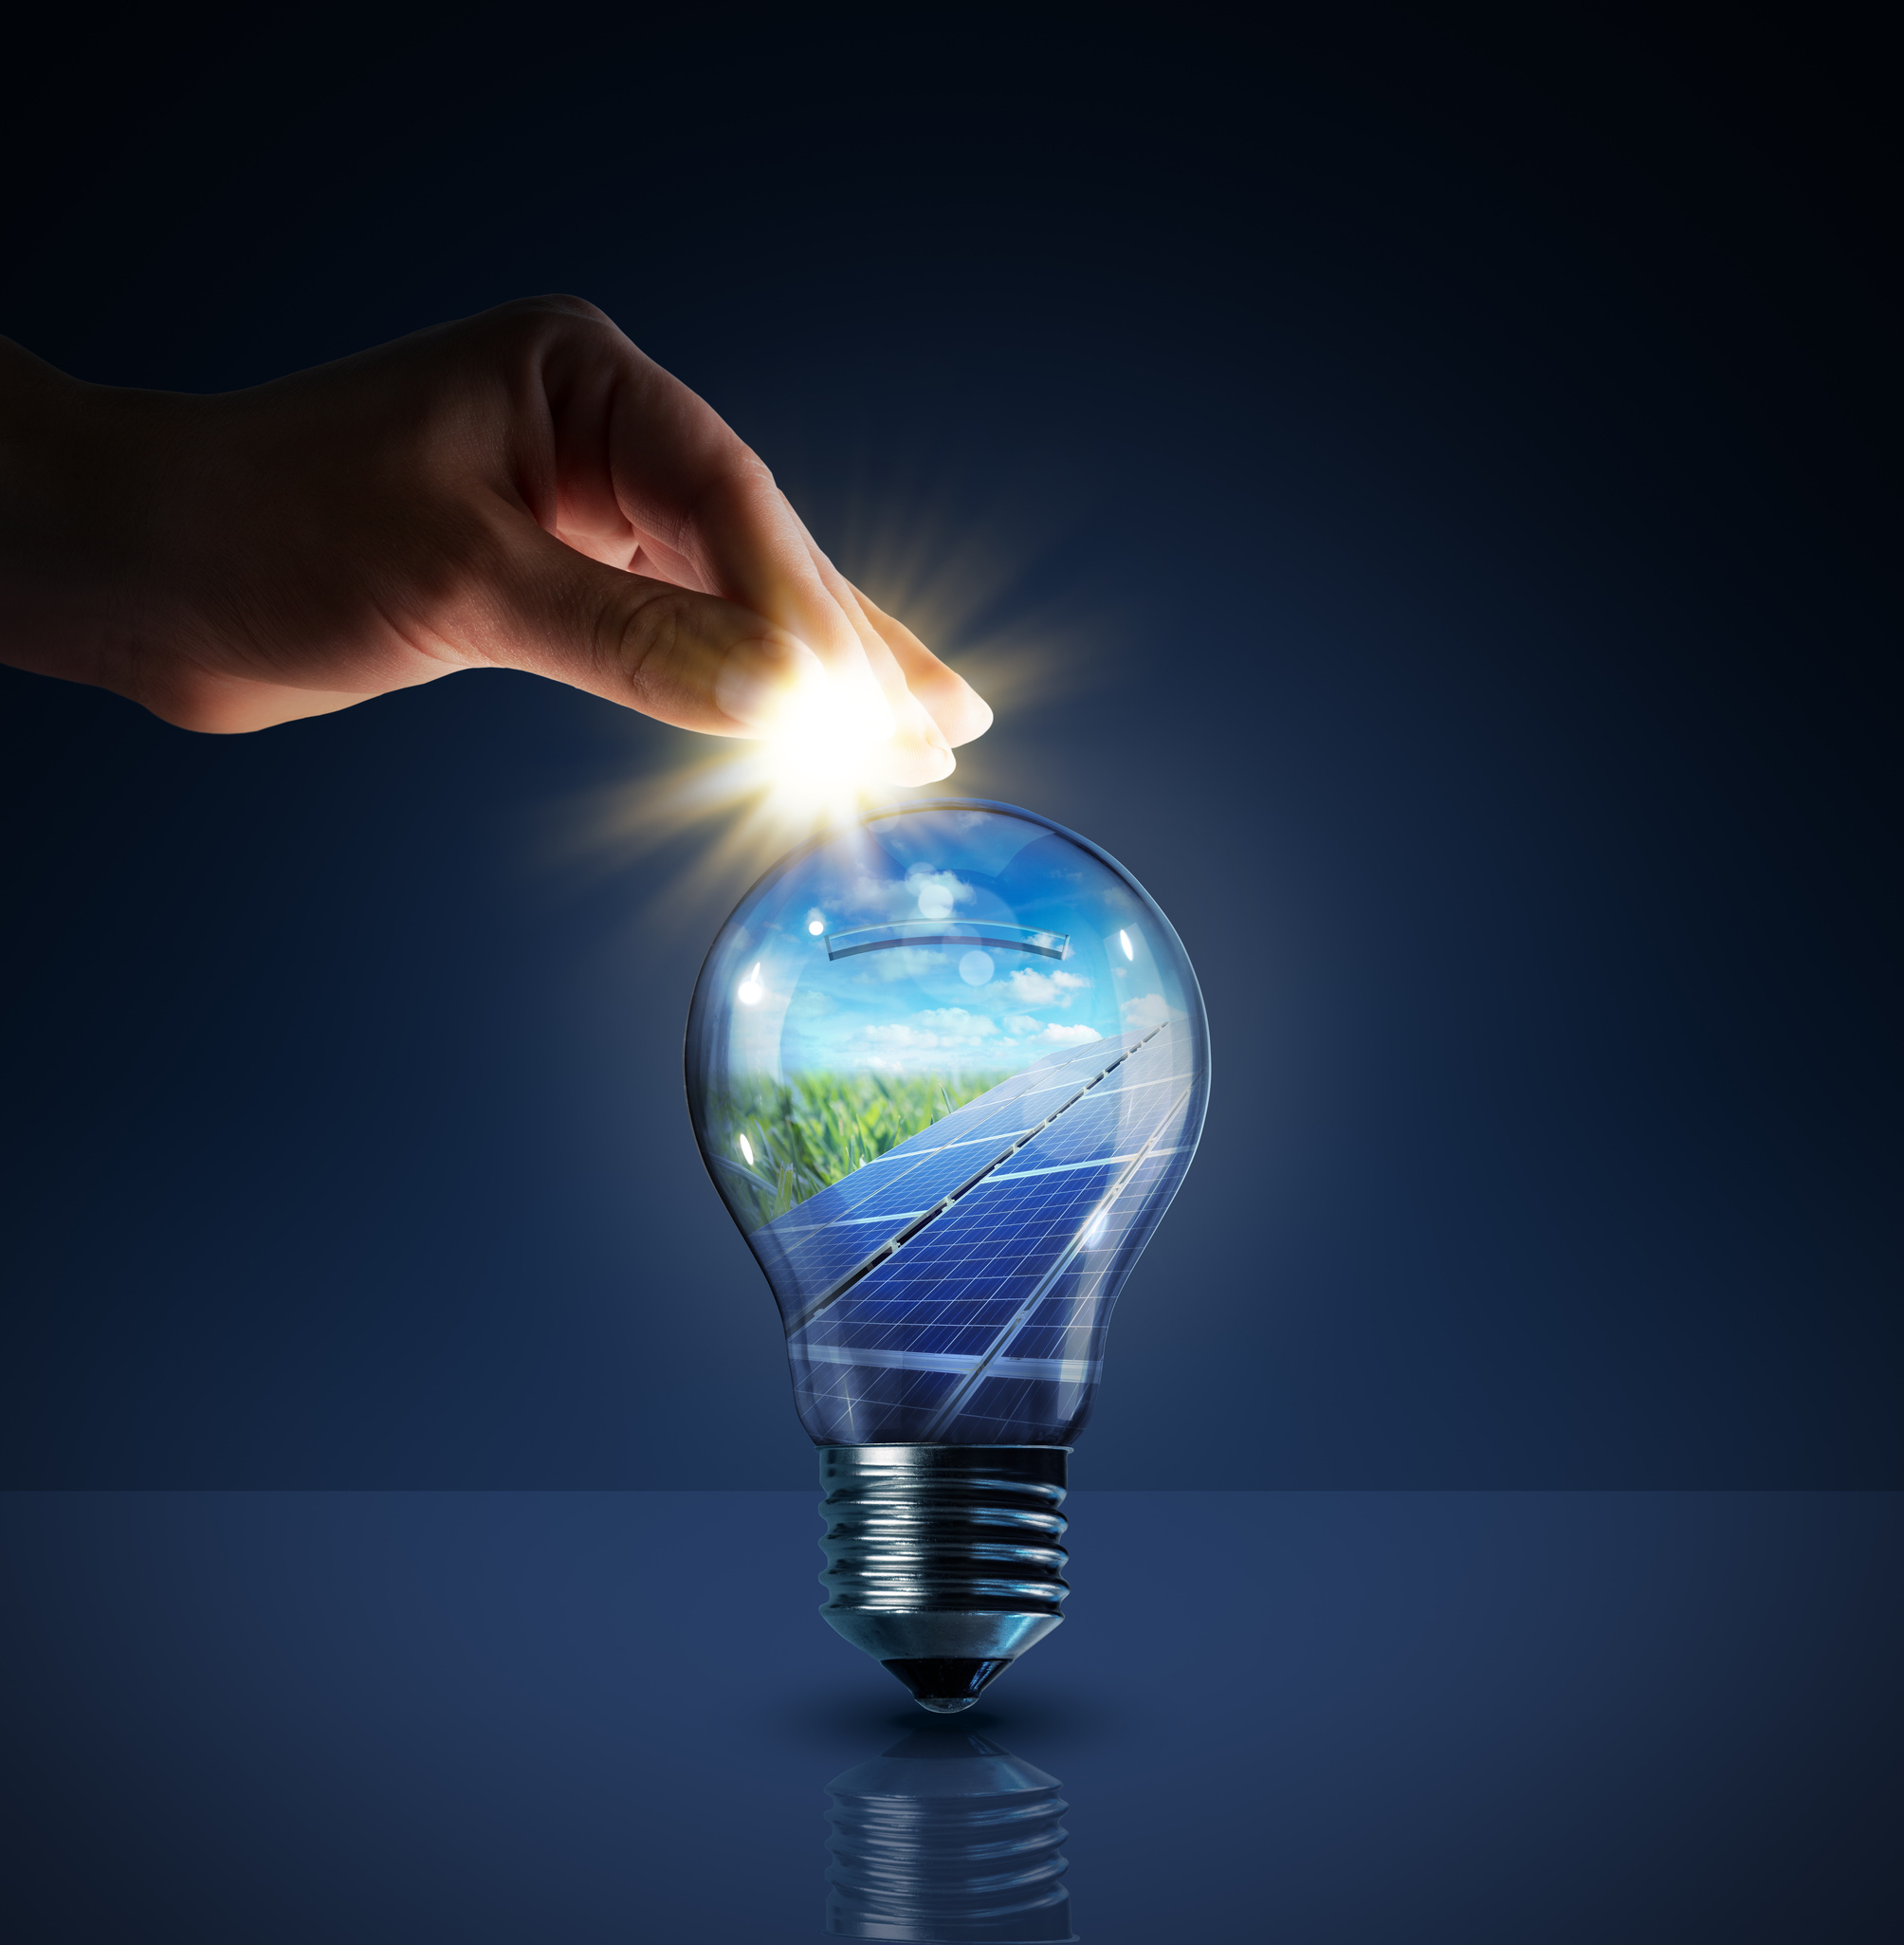




Our Solution
Scope
Reliable Data
Calculated Solution
Clear User Interface
Machine Learning
Notes:
Dani
During our courses one lesson we learned was that the results we will get will be as good as the data we have. And in the age of fake news, we decided to put extra effort in having reliable data.
We used only official sources, like the International Energy Agency, the European Commission and Statistikmyndigheten.
Then used that data to create a formula that would calculate, depending on your electricity zone, and the overall specifications of your house, when you would see a return the capital you invested.
Using AI and ML we've trained a model with that data so we can have a better projection of what electricity prices will be in the next 30 years.

Slide 7
Final Product
DEMO
Notes:
Jag ska ta det här på engelska hoppa det är okej
"I am going to present our app. Firstly, I'd like to explain our price prediction graph. We utilize machine learning to forecast electricity prices for the next 30 years and beyond.
On the left side, we have another graph that displays the distribution of energy sources in Sweden. Notably, solar energy constitutes a relatively low percentage.
At the top of the page, you will find a dropdown menu with four options. You can start by selecting your city in the first option. The second option allows you to choose a solar panel package. In the third option, you can specify the roof slope angle for optimal installation.
In the fourth option, you can select the direction your rooftop is facing. Now, on the right graph, you can observe that it will take approximately 12 years to recoup your initial investment in solar panels. On the left side, you can track how much you will save on your electricity bills each year. There comes a point where you reach the break-even point, and after that, you begin to generate savings in the form of reduced electricity bills.

Slide 8
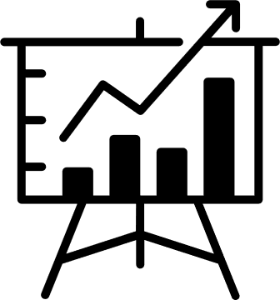




The Techniques
PYTHON
ETL
PROGRAMMING LANGUAGE
CLEANING AND SORTING OUR DATA FROM API AND CSV FILES
GIT
VERSION CONTROL
MACHINE LEARNING
VISUALISATION
PREDICTION
DASH
Notes:
Khaqan --

Slide 9
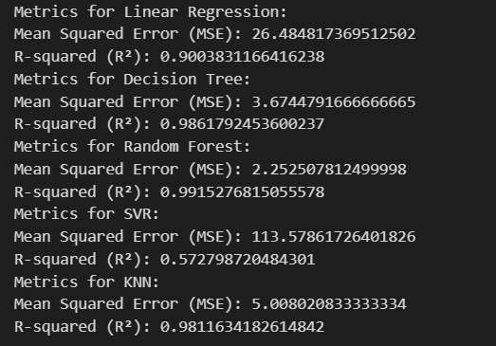
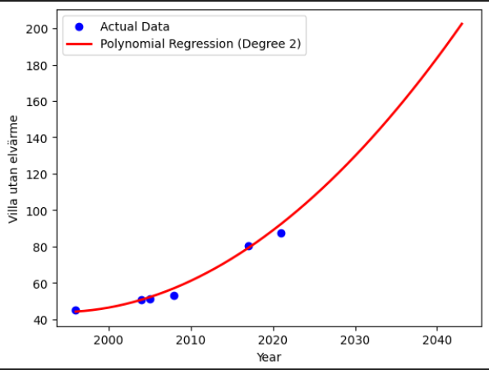
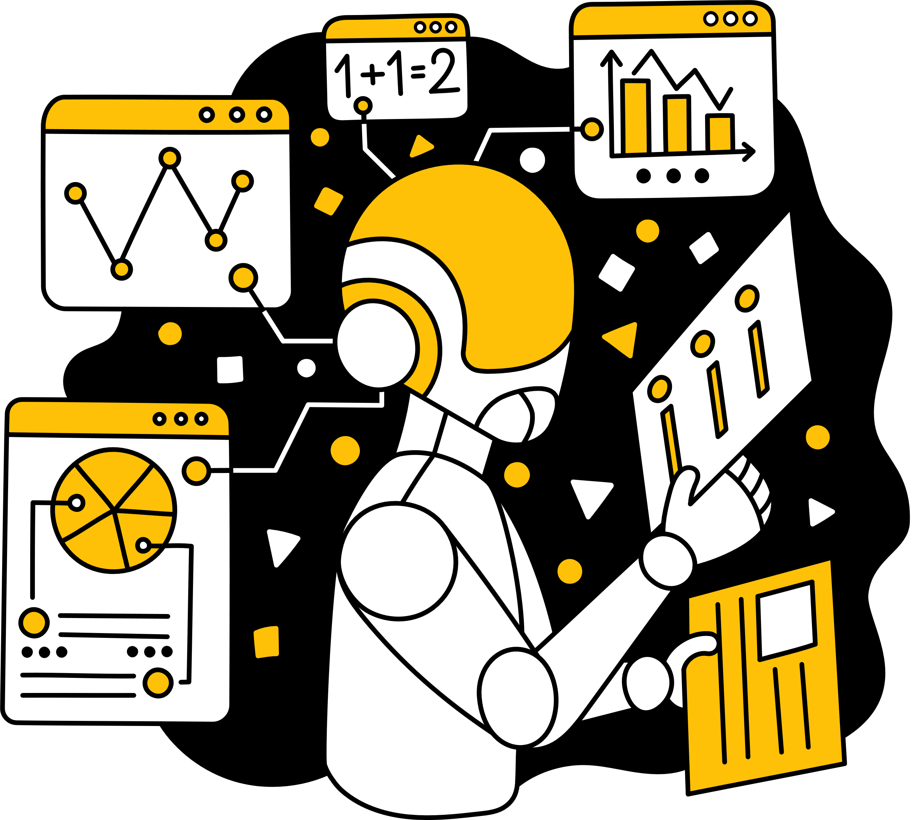
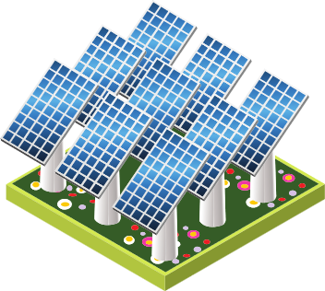
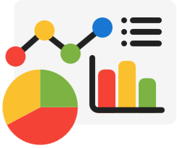
The Code
Trinity
Installerad effekt
X
(taklutning och takriktning)
X
solinstrålning
X
systemeffektförluster
X
minskad effekt
=
Årlig elproduktion
Machine Learning
Solar Panel Object
Dash
Notes:
-Class
- Machine Learning
- Dash
Moving headlines become a triangle.
- Khaqan First
- Simon continues..

Slide 10

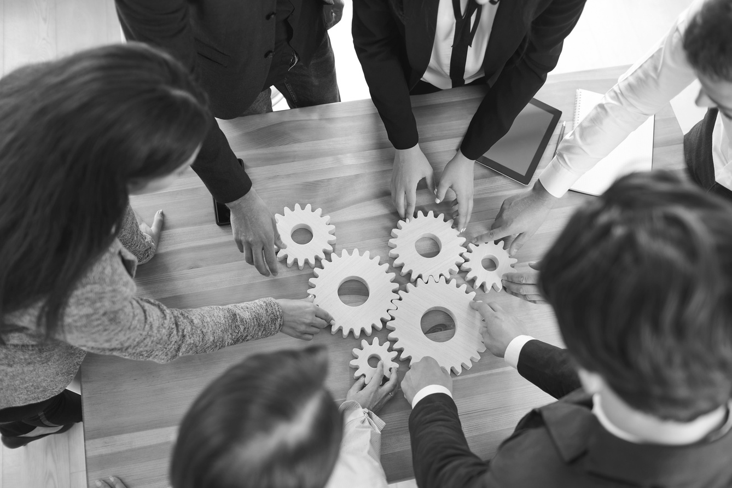
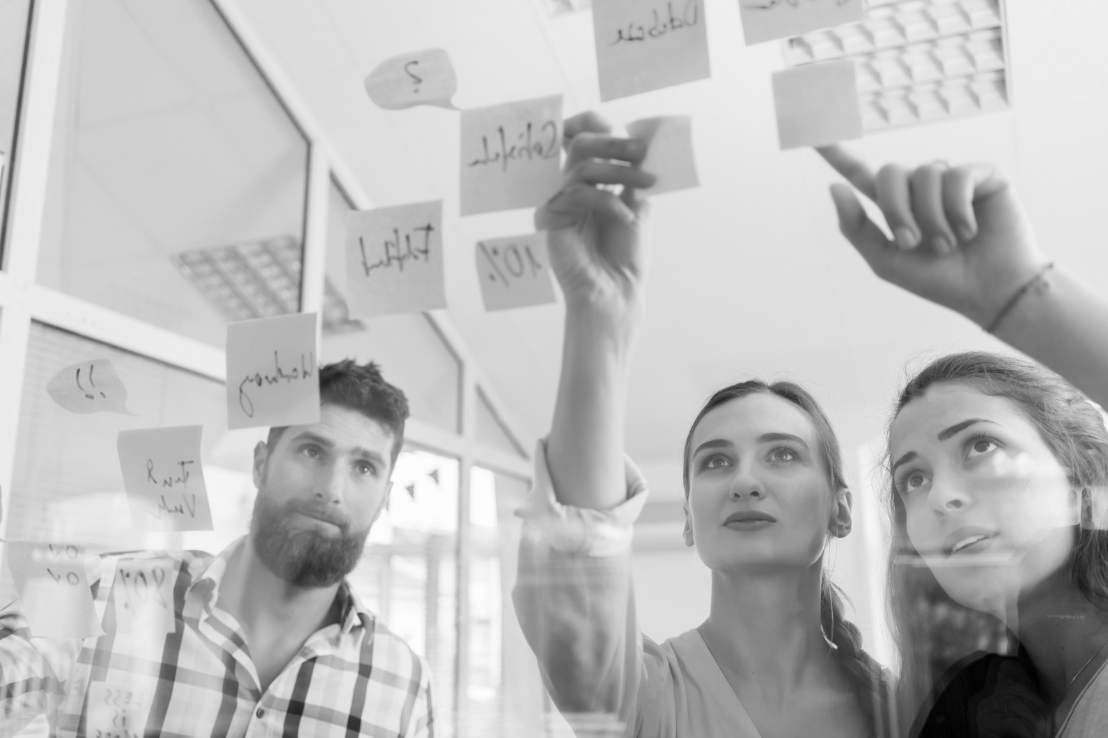
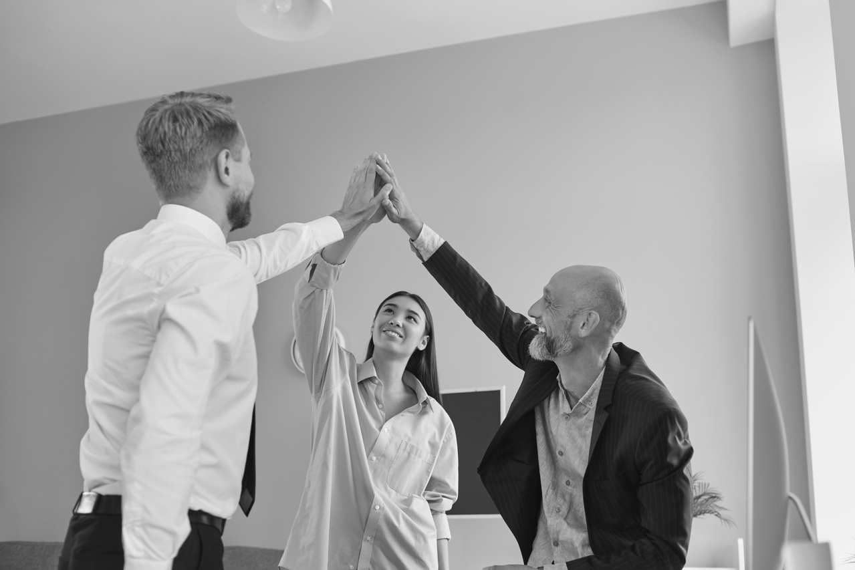
Task Allocation
GATHER DATA
ETL
LAUNCH
VISUALISATION
..
THE GATHERING OF DATA AND CHECKING OF THE SOURCE
USING API AND HARMONIZING DATA
LAUNCH APPLICATION ON CLOUD
THE VISUALIZATION OF THE PROJECT. BOTH DASHBOARD AND PRESENTATION
Notes:
En av de största uppgifterna under detta projekt har varit att samla in data och hitta rätt data från pålitliga källor. Vi alla har hjälpts åt och suttit många och långa timmar för att hitta rätt.
ETL extract transform load
Jag och simon varsitt script
Anropar api, sida man via kod kan nå deras data
Städa data passa vår app
medan jag och simon etl
Jobbade Daniela och Khaqan få upp vår app på molnet
Är live efter presentationen ta del
Och en sista stor uppgift var det visuella. Dashboarden som vi byggt har samtliga varit inblandade i, Simon och Khaqan har jobbat med vissa av graferna, jag och Daniela har jobbat med dom andra.
Daniela är även the mastermind bakom vår powerpoint presentation.

Slide 11
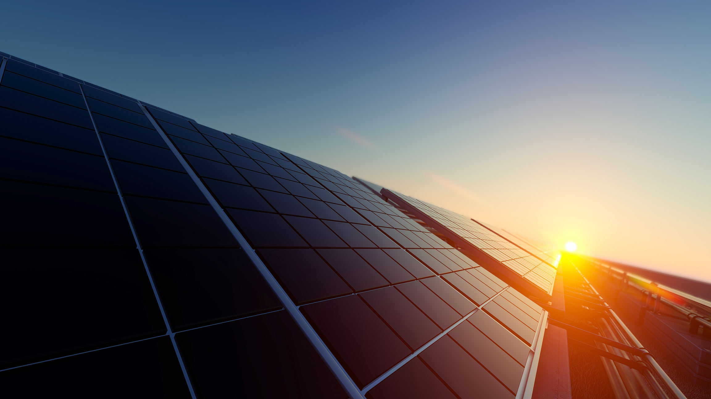

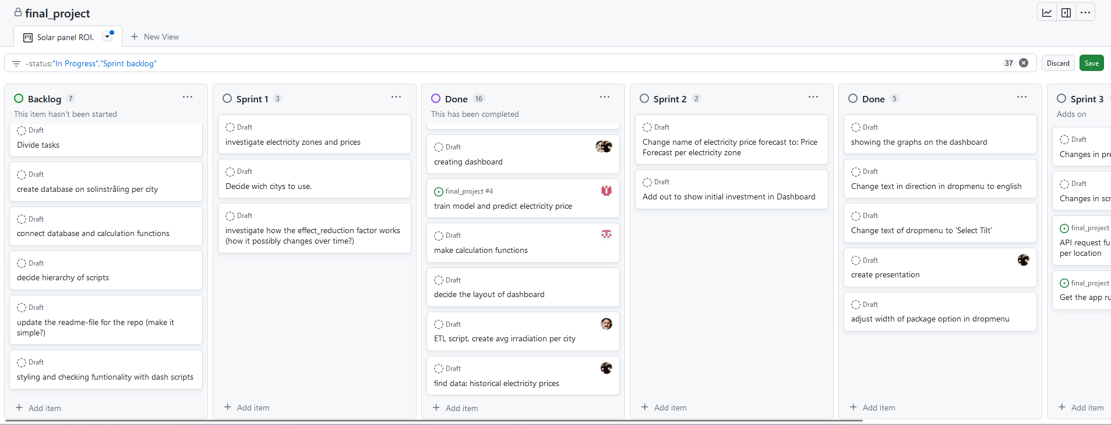



Agile Methodology
Tools
GIT
Flexibility and version control.
Kanban Board
Organization and status.
Scrum Team
Daily scrum, sprint review.
Teams
Communication and meetings.
Notes:
hello again.
Another technique we used was an agile approach to our way of working.
We had limited time, several steps and many times we were sitting in different locations.
Our project and us, needed to be flexible and adaptative.
For this we used first of all
GIT: Life happens right? You get a call to pick up a sick kid from school, someone falls off the bed and you need to quickly swish focus. Git allowed us to pick up where some someone left off, so we keep the flow of the project.
Kanban. Our Kanban board allowed us to see the big picture.
Everything that needed to be done but also how far we had moved in the progress. Here you can see an example of backlog, our SPRINT PLANNING and process.
One of our agile ceremonies was our daily stand ups, led by Henry, our scrum master, where we summed up what had been done the previous day, what we want to achieve and if we saw any challenges ahead. This also allowed us to help each other and rearrange tasks for both the sake of the project and our own development.
And lastly, we used Microsoft teams to stay connected when working distance and use different virtual rooms when paircoding or discussing layouts. This way we could be in touch but also divide the group in 2 teams.

Slide 12
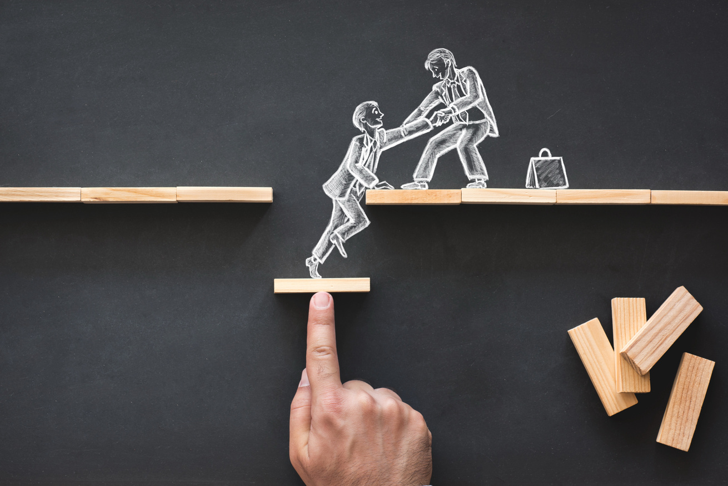
Reflection
Productivity and workflow
Examinate data
Priorities
Everything takes longer than expected
Notes:
Simon

Slide 13
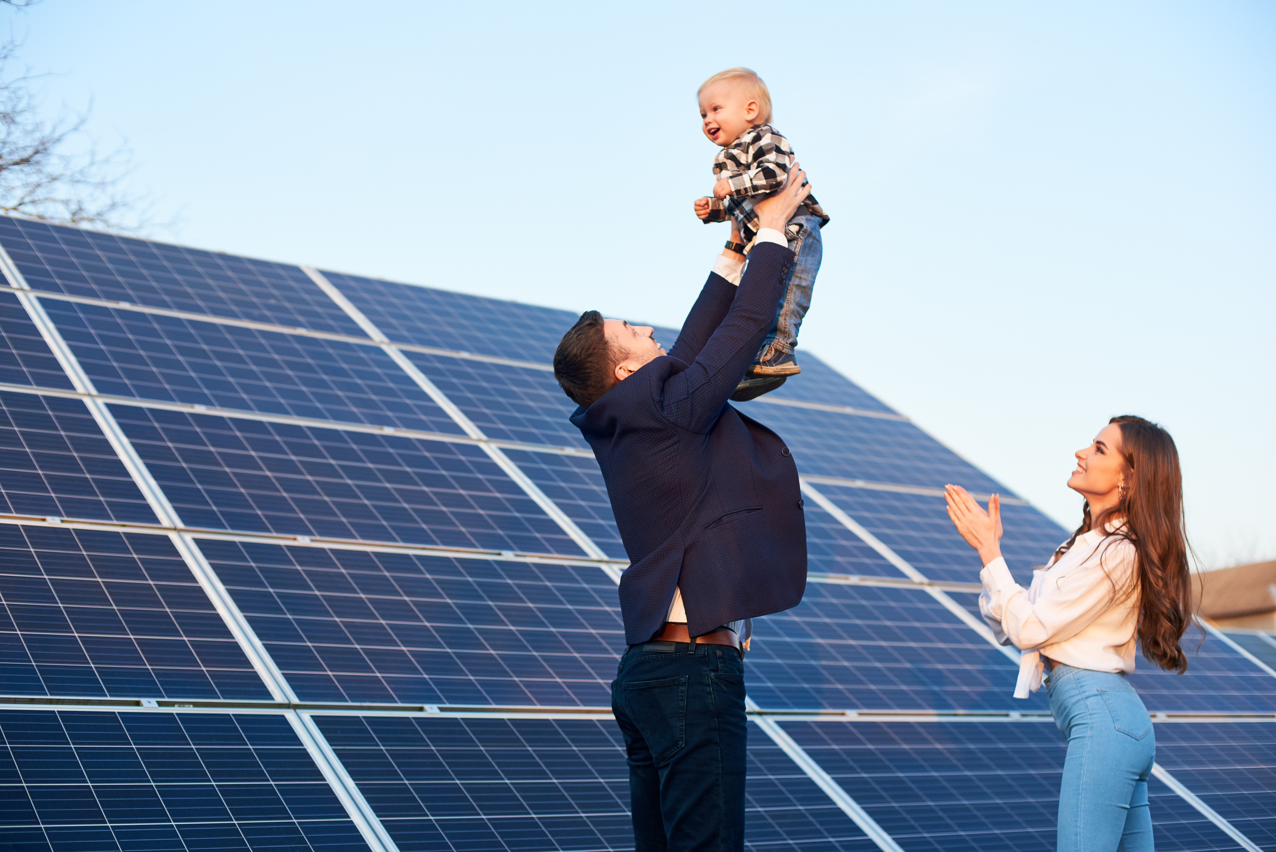
Vision
Next Steps
Include more solar panel suppliers.
Add more parameter to be more precise. Expand to companies and governmental institutions.
Include a comparison between investing in solar panels versus savings account/fonds.
Notes:
We've shown you what we've accomplished with our app so far, but there's always room for improvement. Here are three key areas to consider:
More Solar Panel Options: Expand the range of solar panel suppliers for more choices for customers ,coz right now we are using one supplier only (ikea)
Fine-Tune Predictions: Improve accuracy by adding extra parameters. Consider extending the app's use to businesses and government.
Compare with Savings: We can provide users with a valuable perspective by including a feature that compares the financial benefits of investing in solar panels with other traditional investment options, such as savings accounts or investment funds

Slide 14
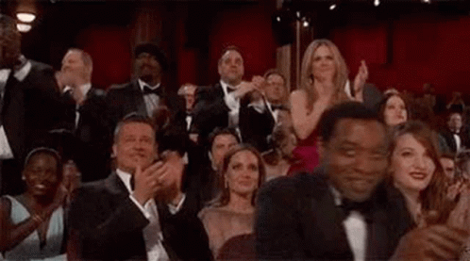
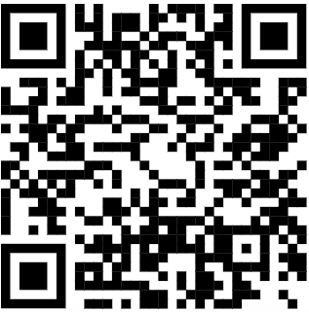
Hasta la vista, baby
Q&A
Notes:
With that, we're all set with our presentation! Feel free to dive into our live app with these new features. We're excited to hear your questions and love to get your feedback to keep improving our app.

